Slide 1
Project 1: Tic Tac Toe
By Haiting Zhu
Notes:
放一个ttt的图片当背景也可以

Slide 2
Content
Project Summary
Part I: Basic Tic-Tac-Toe
Algorithm: MINIMAX
Competition between Human and AI
Part II: Advanced Tic-Tac-Toe
Program structure
Algorithm explanation: H-MINIMAX, alpha-beta pruning
Competition between Human and AI
Self-examination

Slide 3
Project Summary
Aim: Construct the program to play Tic-Tac-Toe with human
Tool(Language): Python 3
Individual work
Result: Works most optimally in basic Tic-Tac-Toe game while makes several mistakes in advanced Tic-Tac-Toe game(but works pretty good under most conditions)

Slide 4
Part I: Basic Tic-Tac-Toe Algorithm
 | O
O | X | X
Max-value(X)
Return: 0
 | O
O | X | X
X | O
O | X | X
 | O | X
O | X | X
 | O
O | X | X
X
Min-value(O)
…
Return: 1
Return: 1
Return:0
Return:1
X | O
O | X | X
O
X | O
O | X | X
 | O
X | O
O | X | X
 |  | O
X | O | O
O | X | X
Max-value(X)
Return: 0
Return: 0
Min-value(O)
X | O | X
O | X | X
O
X | O
O | X | X
O | X
X | O
O | X | X
O |  | X
Terminal state
Return Utility:1
Algorithm in basic TTT program:
Explore every possible state and use MINIMAX function to simulate the game as every player perform most optimally. Under such a condition, the program return the wisest move for AI.
Return: 1
Return: 0
Max-value(X)
X | O | X
O | X | X
O | O
X | O | X
O | X | X
O |  | O
Terminal state
Return Utility:1
X | O | X
O | X | X
O | O | X
X | O | X
O | X | X
O | X | O
Terminal state
Return Utility:0

Slide 5
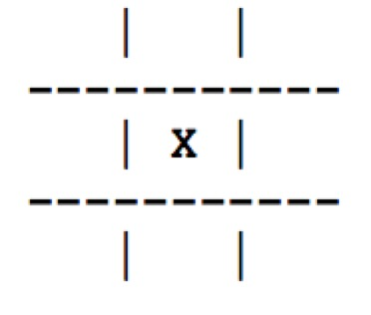
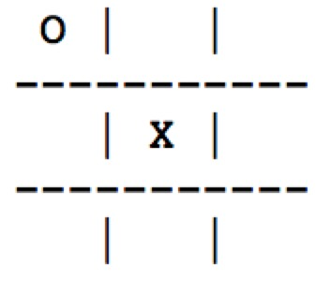
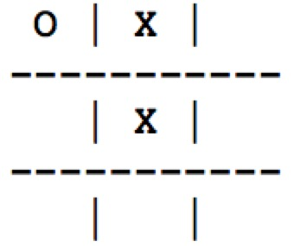
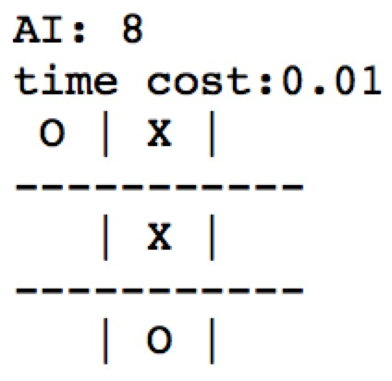
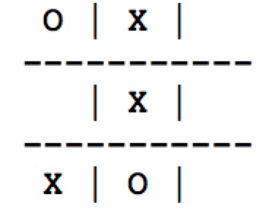
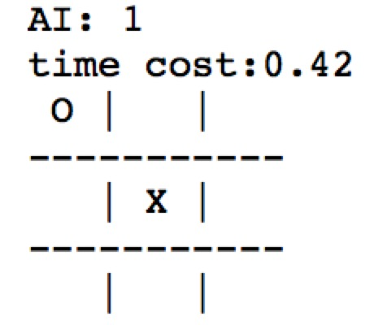
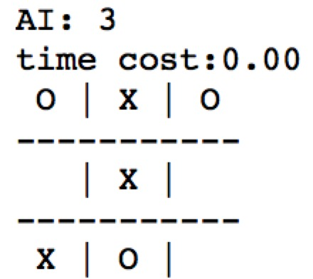
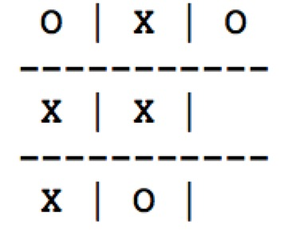
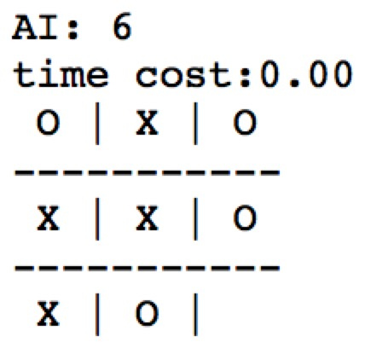
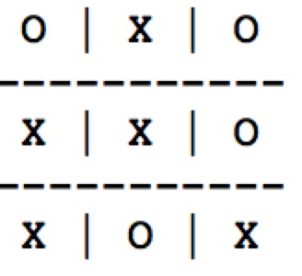
Part I: Basic Tic-Tac-Toe Competition between human and AI
Human: 5
Human: 2
Human: 7
Result: Draw
In another case where AI plays first, it cost about 4 seconds to find the first move while other moves will only cost less than 0.1 second. This is because it will construct the biggest(deepest) tree to find the first move which needs about 9!=362880 Operations.
Human: 4
Human: 9

Slide 6
Part II: Advanced Tic-Tac-Toe
Rule changes:
Grid: 3*3 → 9*9
Move constraint: play in the corresponding board decided by the previous player, but if the small board is full, the move can be anywhere
How to win: win a single small board like in basic TTT
Difficulty comes…
Only MINIMAX can not solve the problem in acceptable time, the depth of the search can be as big as 81 (in basic TTT, it is only 9 and will cost 4 seconds to get the result)
New algorithm needed:
H-MINIMAX
+
Alpha-beta pruning
+
Small tactics for move under certain condition

Slide 7
Part II: Advanced Tic-Tac-Toe program structure
Initial State
Use the list to construct a two-dimension board
1. If AI plays first, the first move is the center of the board(5,5), this grid has the biggest possibility to win (similar to the basic TTT)
Actions
2. Get previous player’s move and find possible moves in the corresponding small board(if that board is not full)
3. If that small board is full, choose 9 random moves
Result
Use the list to represent the result state
1. Test whether game is over and return result of the game
Terminal test
2. Cutoff test: as mentioned above, to ask program to explore every move is impractical(the search tree is too deep), the program should stop searching under certain condition and make decision. In this program, I limit the search depth(depth <= 6)
Utility
1. For terminal state, return the final numeric value of the game for AI
2. For non-terminal state, return the evaluation result of the game for AI, namely, the chance to win
1. H-MINIMAX(like basic TTT): suppose every player will make the wisest decision, simulate the game (not the whole game) and find the move with most possibility to win
Strategy
2. alpha-beta pruning: record the best choice for AI and human along the path and thus eliminate some search if next move definitely won’t be considered as the best choice for AI or human

Slide 8
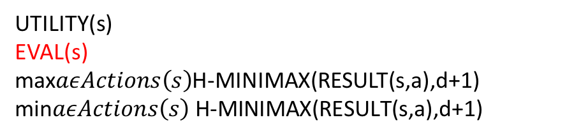
Part II: Advanced Tic-Tac-Toe Algorithm explanation(1/2)
H-MINIMAX
UTILITY(s)
EVAL(s)
max$aεActions\left(s\right)$H-MINIMAX(RESULT(s,a),d+1)
min$aεActions\left(s\right) \text{H}\text{−}\text{MINIMAX}\text{(}\text{RESULT}\text{(}\text{s}\text{,}\text{a}\text{),}\text{d}\text{+1)}$
If TERMINAL-TEST(s)
If CUTOFF-TEST(s,d)
If PLAYER(s)=MAX
If PLAYER(s)=MIN
* Except the function with red color, other functions are same as that in basic TTT
Cutoff-test
Assign a specific depth as the indicator that the program should stop running. According to the performance of different depth, the program is limited to depth 6(see next page).
Evaluation Function
Return an estimated chance for AI to win:
Scan every small board, check each row, column and diagonal line. If there are two moves from same player and the other box is blank, then that player gets two points;
Calculate the scores of two players respectively and the estimated chance for AI to win is (AI’s score – human’s score);
The result is not accurate, but it is close to the real result. As AI has more points than human, it has more opportunity to make up the final blank box with its flag and win the game.
For this non-terminal state:
AI(X): 8 points Human(O): 12 points
AI-Human: -4 points
Notes:
补足分数

Slide 9
Part II: Advanced Tic-Tac-Toe Algorithm explanation(2/2)
Only H-MINIMAX can not solve the problem:
Need pruning (use alpha-beta pruning from textbook):
Impractical
Much better!
Depth 6 is practical, use it in program
Limited Depth
Limited Depth

Slide 10
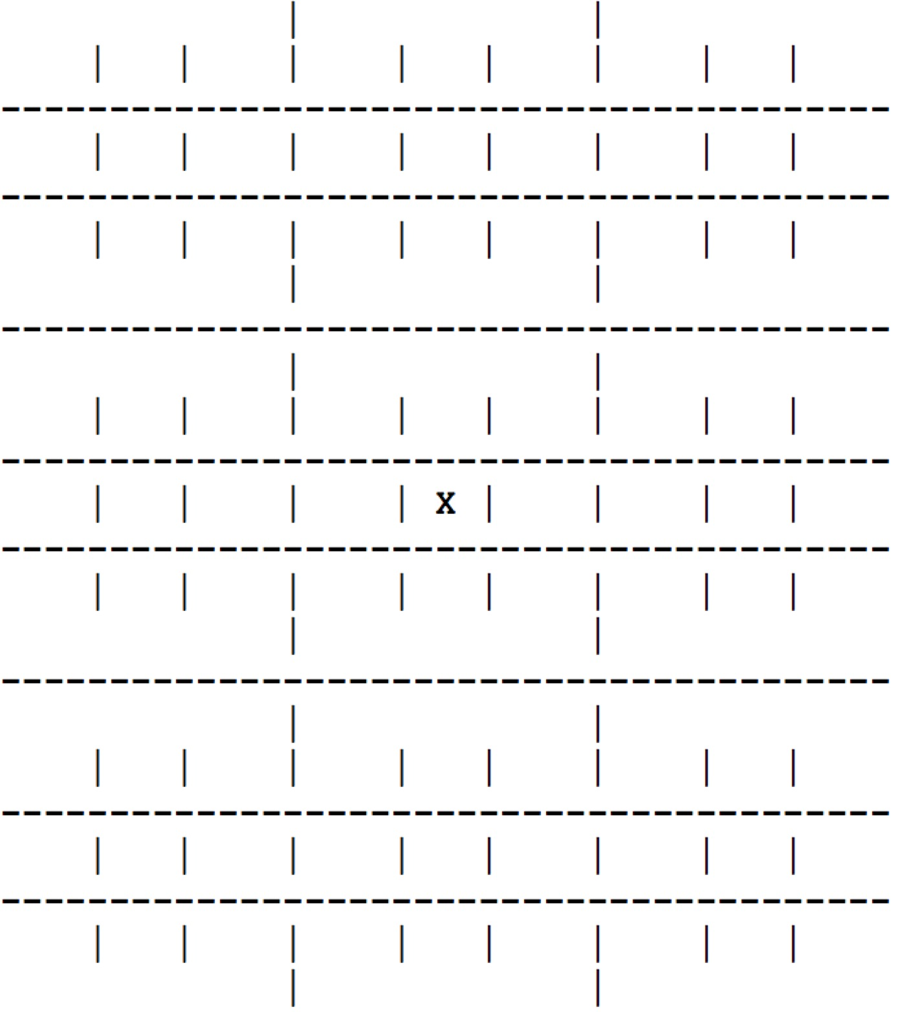
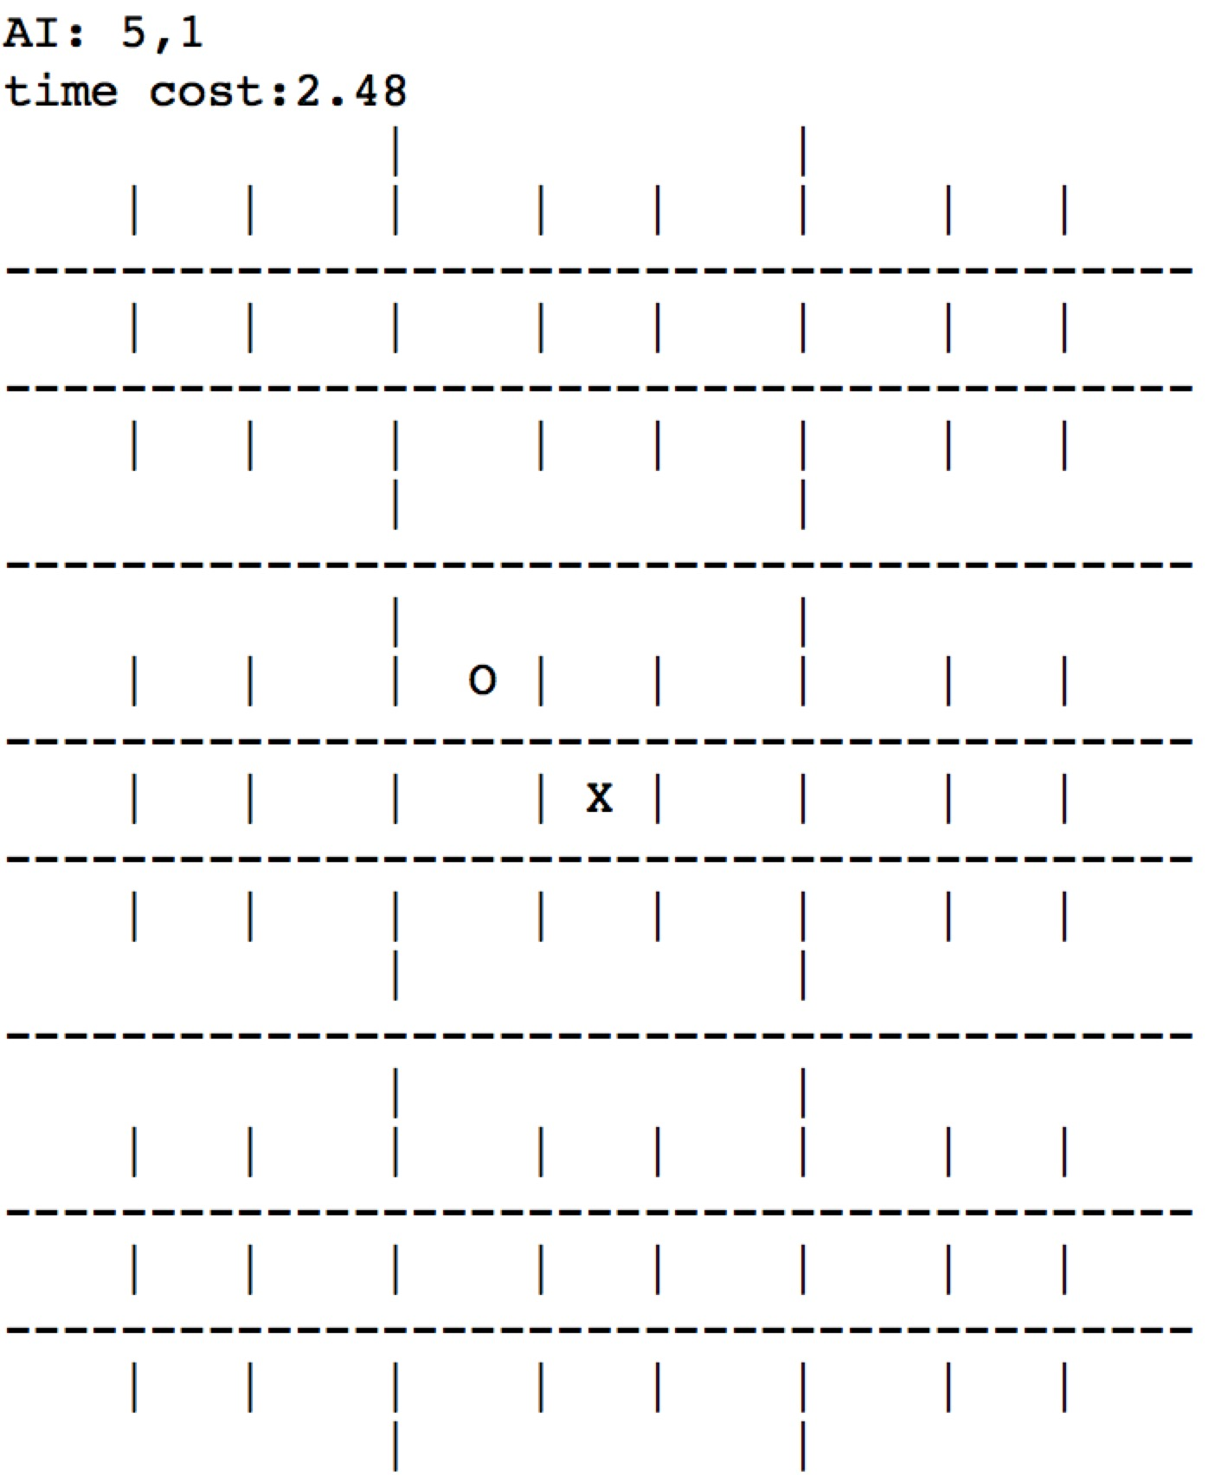
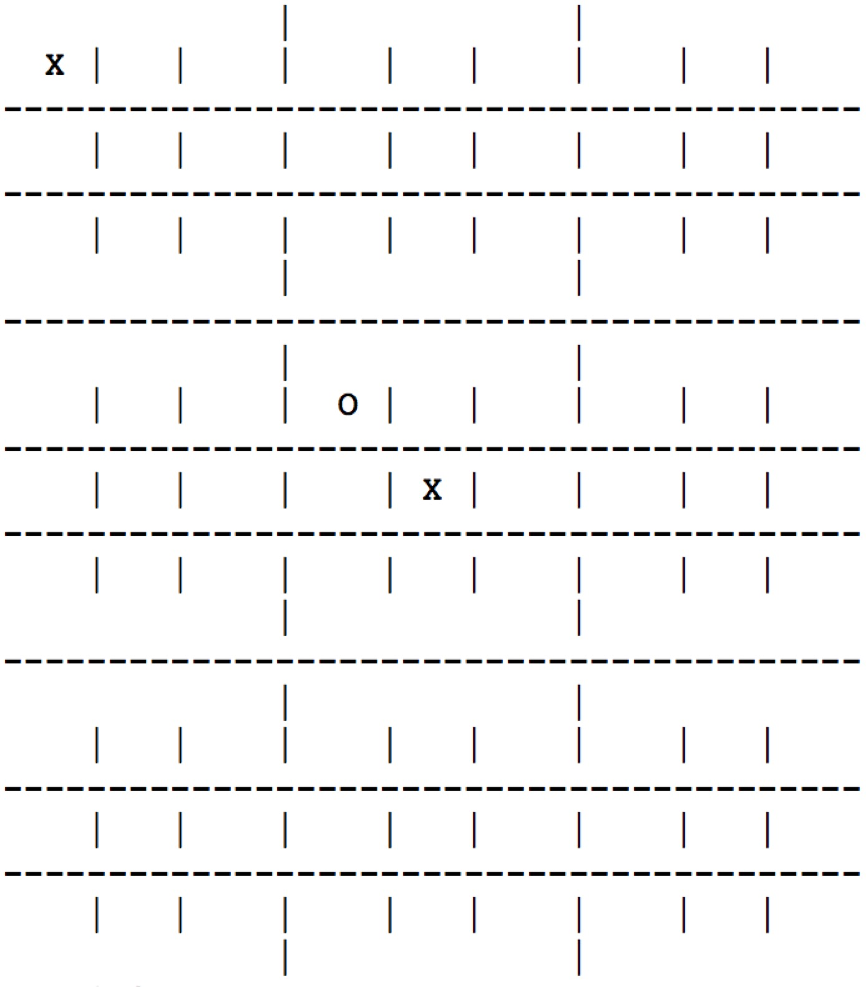
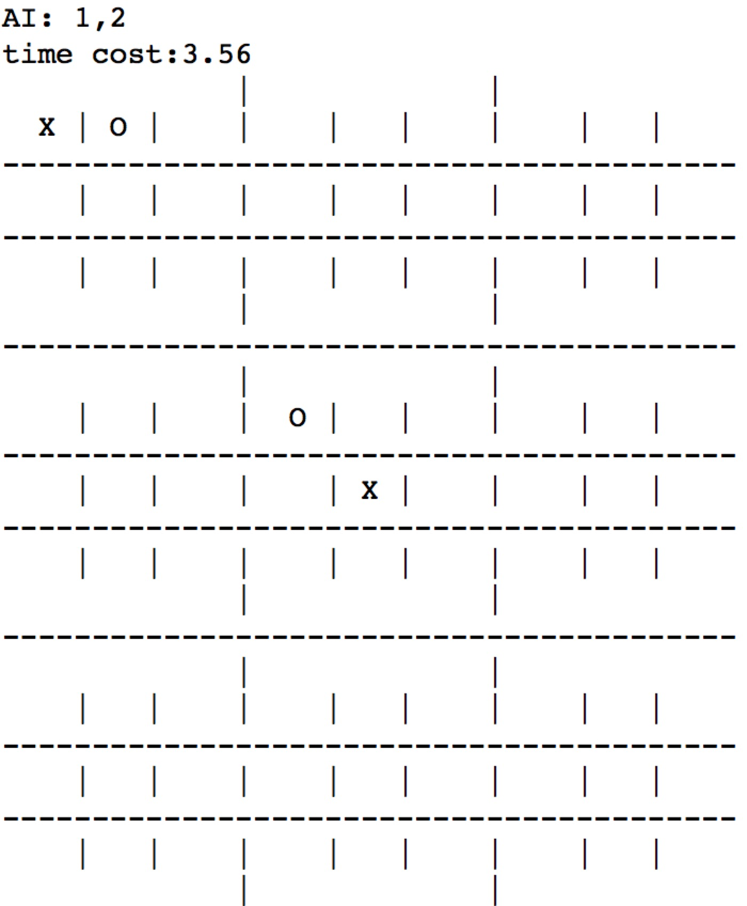
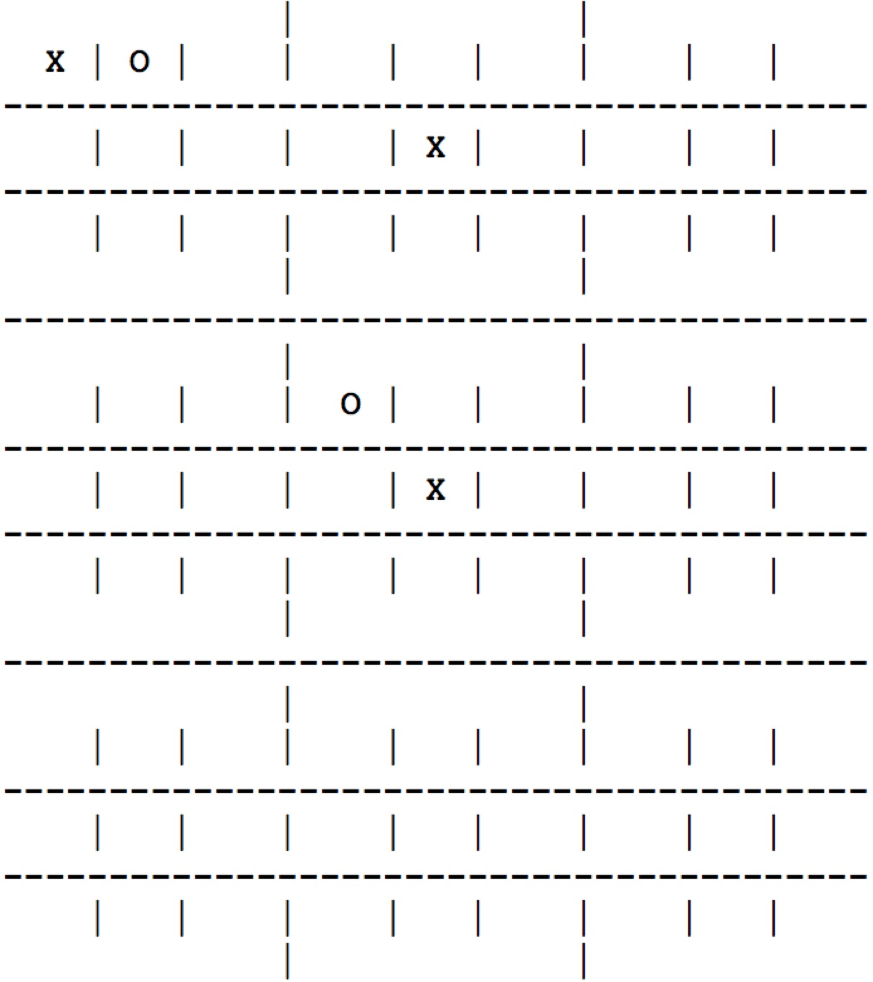
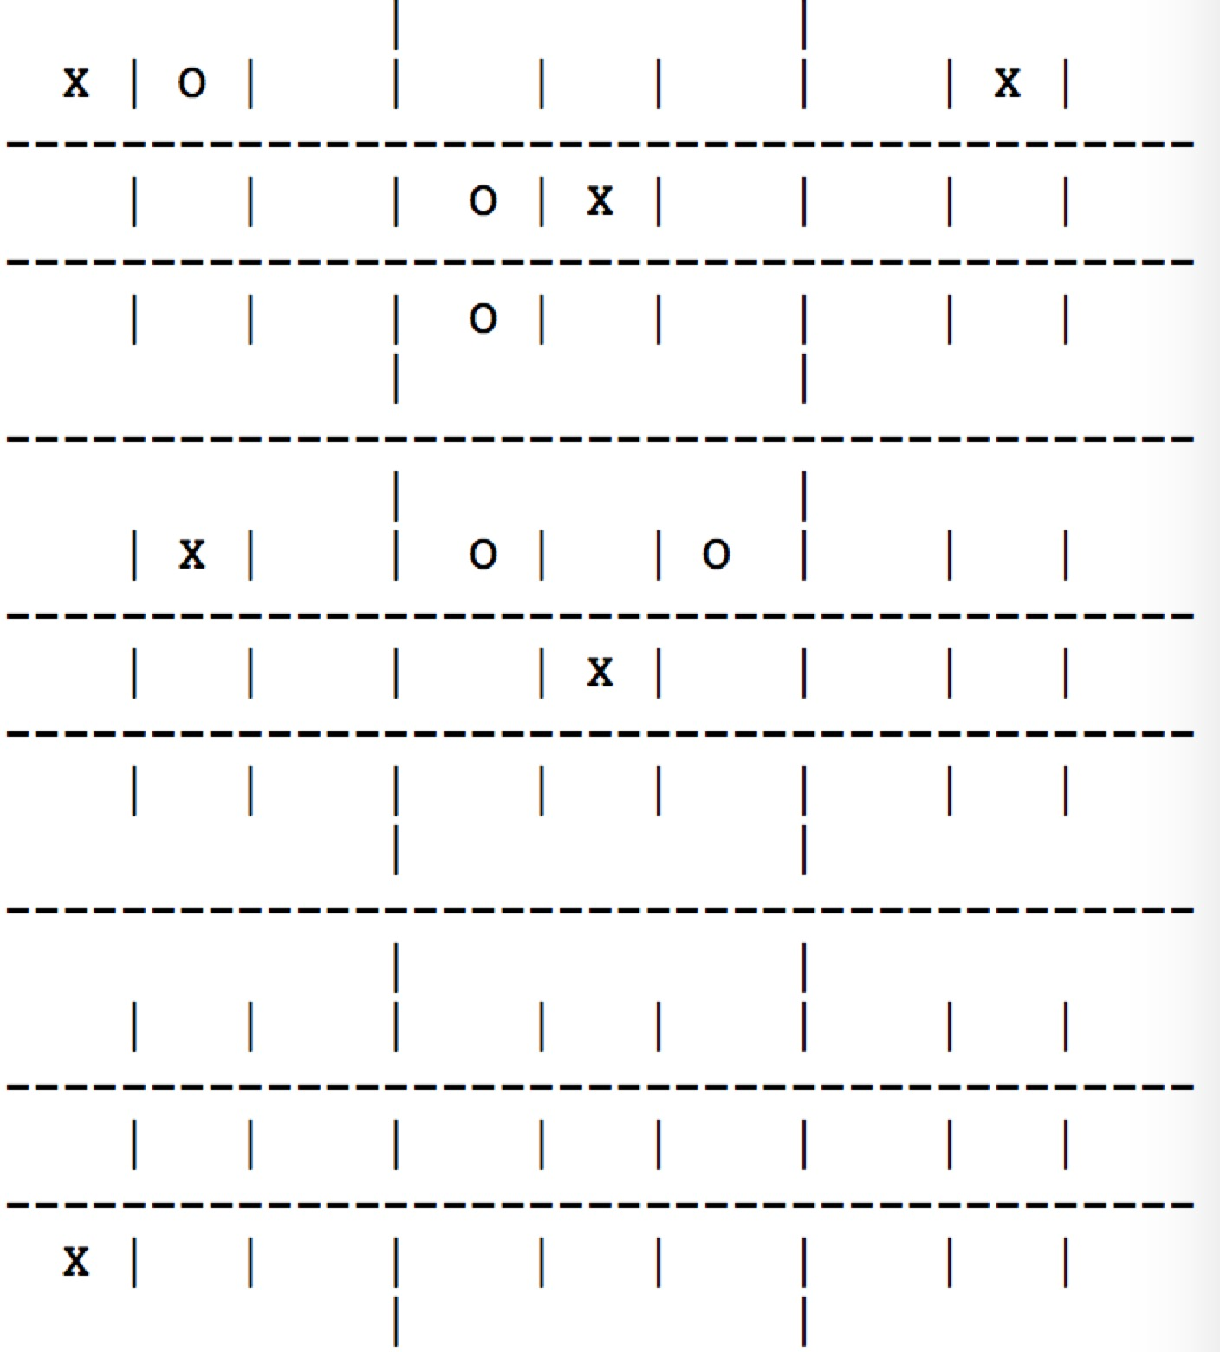
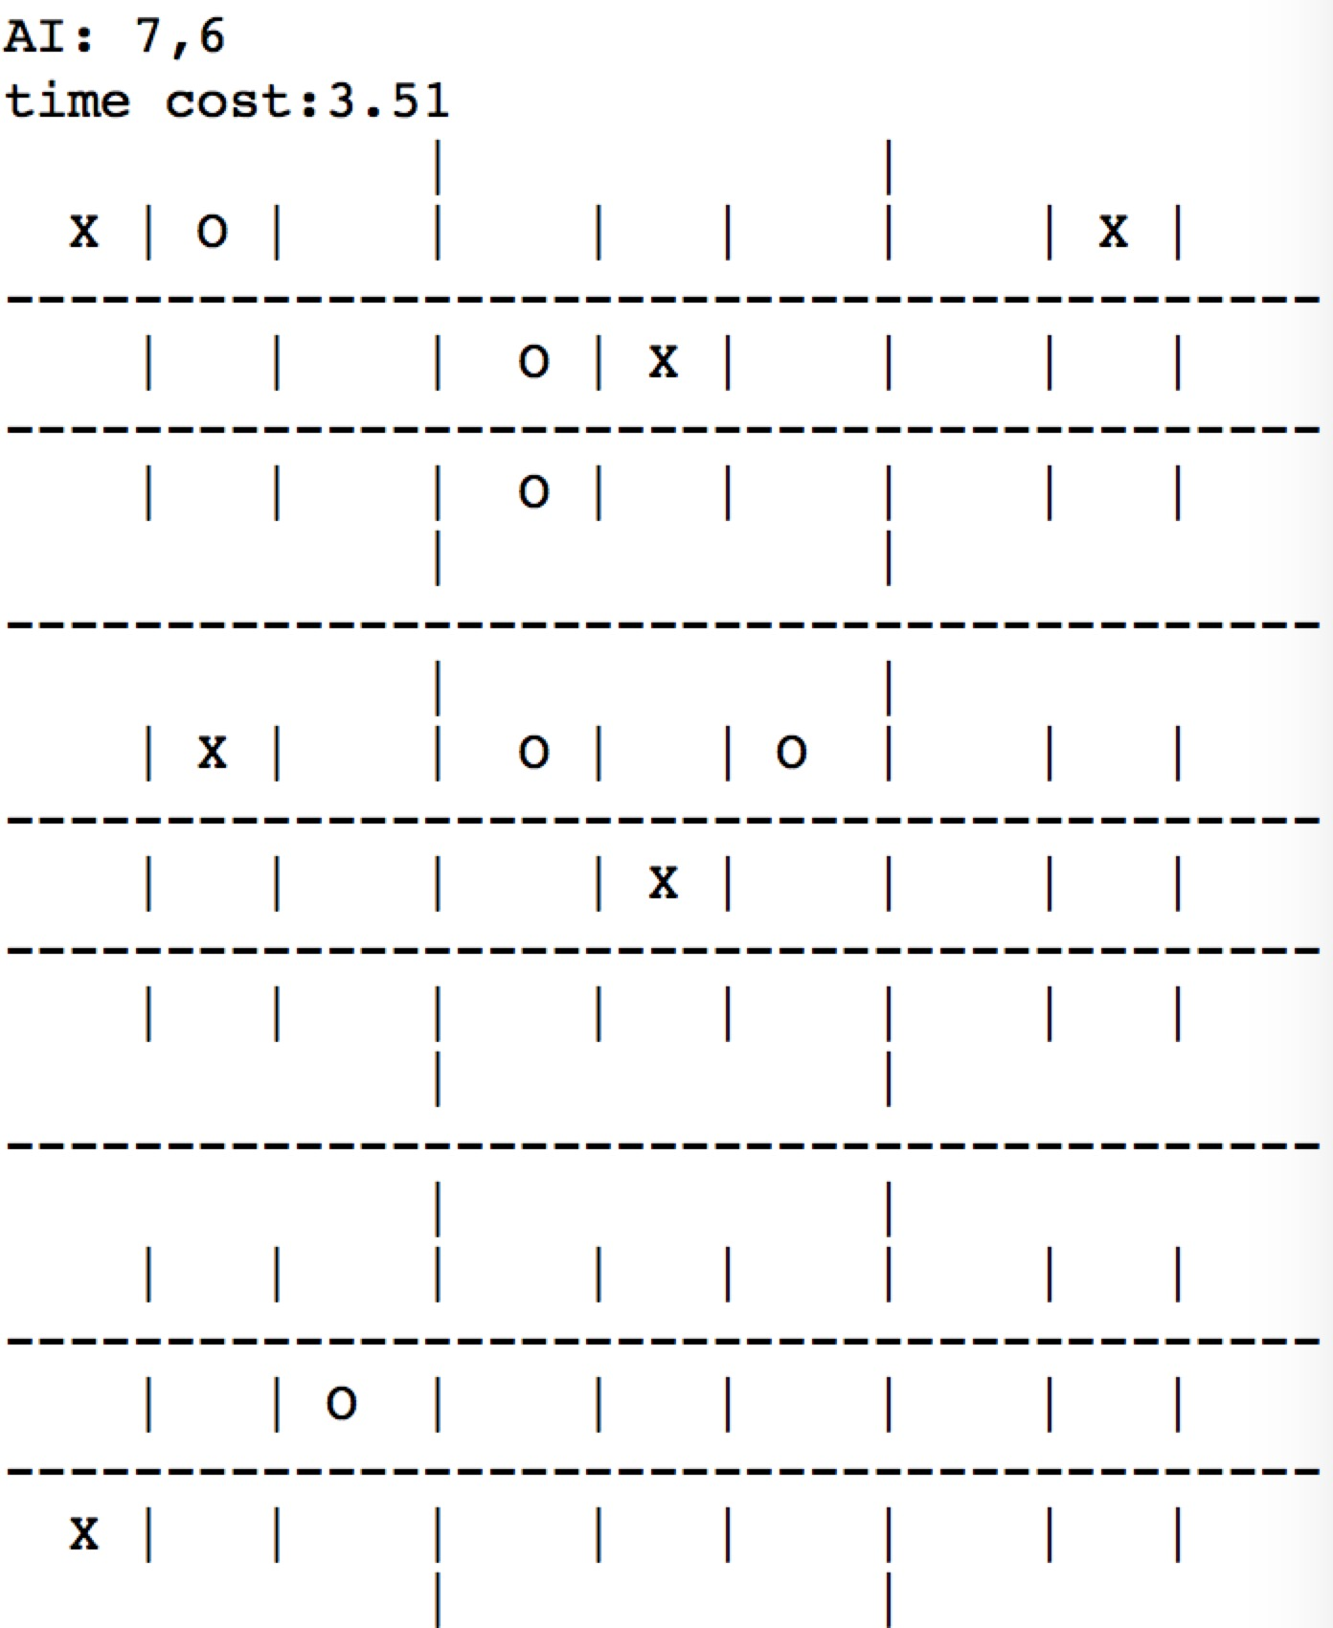
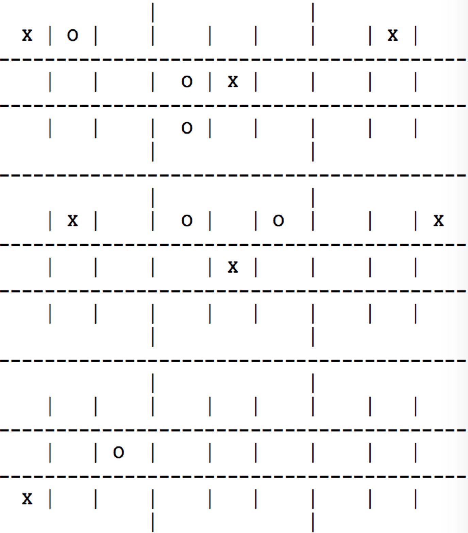
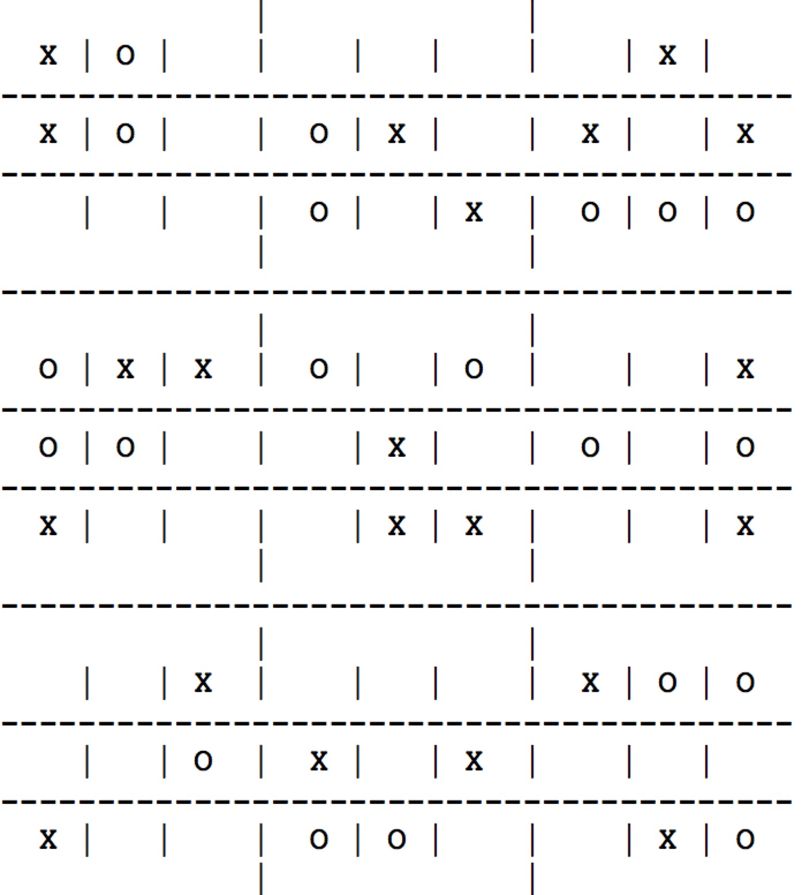
Part II: Advanced Tic-Tac-Toe Competition between human and AI*
…
Human: 5,5
AI: 5,1
Human: 1,1
AI: 1,2
Human: 2,5
Result: AI wins
…
…
Human: 7,7
AI: 7,6
Human: 6,3
AI: 3,7
* Full game is in file “advanced TTT between human and AI.txt”

Slide 11
Self-examination
1. Should try more evaluation function. In this case, my AI beats human and another AI(from Xuexun Xiao), which indicates that this function is acceptable and also simple. But actually, this simple function should be polished and have better performance;
2. Should try to improve alpha-beta pruning algorithm by sorting the value of the subtree, which will improve the program’s performance;
3. The coding style is not that good, which needs more practice…

